Slide 1
MediCall
Fall 2018: BME Senior Design
Deepthi Nacharaju
Lizbeth Leapo
Haeryn Kim

Slide 2
Introduction

Slide 3
Specifications

Slide 4
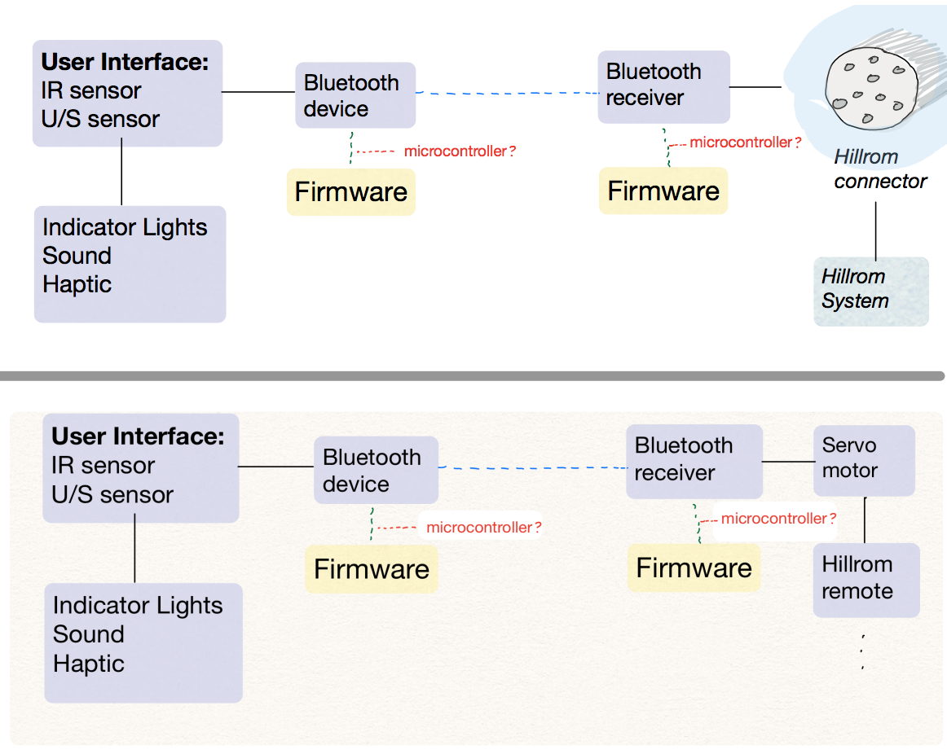
Objectives: Functional Decomposition

Slide 5
Objectives: Battery vs Main Power Line
Haeryn

Slide 6
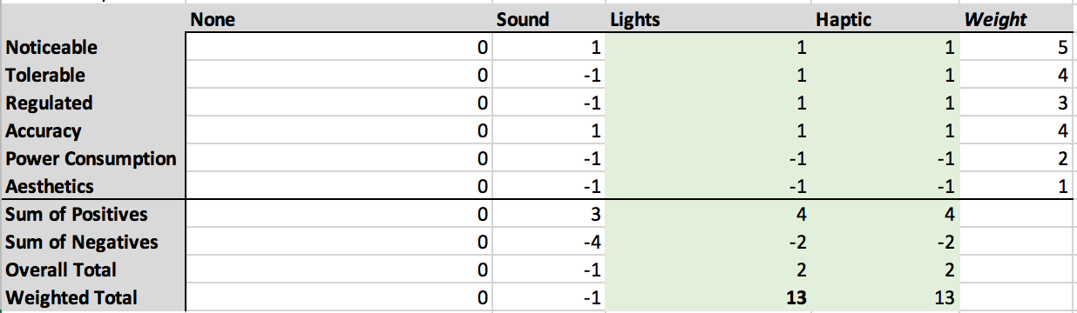
Objectives: User Alert

Slide 7
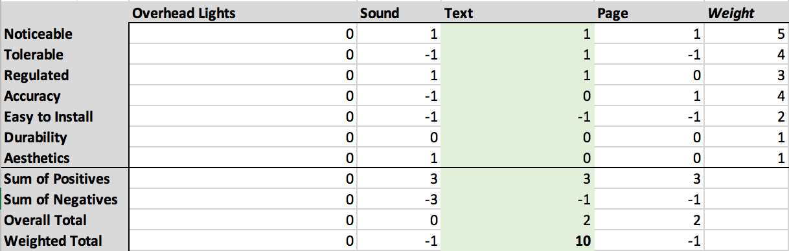
Objectives: Nurse Alert

Slide 8
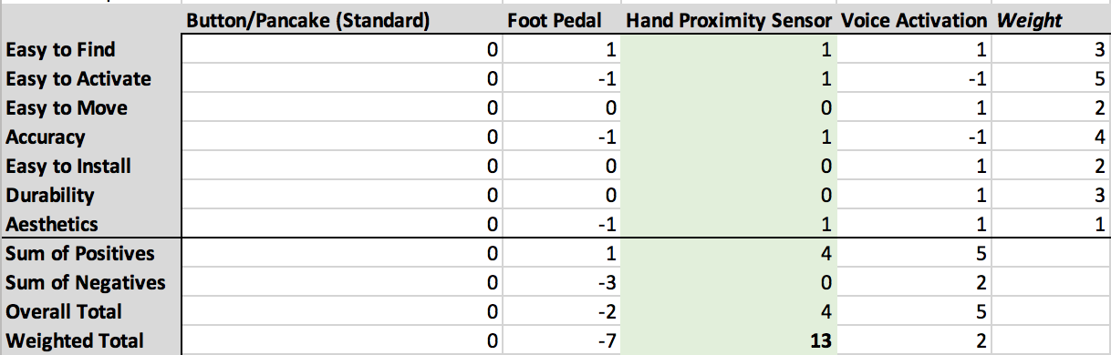
Objectives: User Input

Slide 9
Objectives: Bluetooth vs Wifi
?????

Slide 10
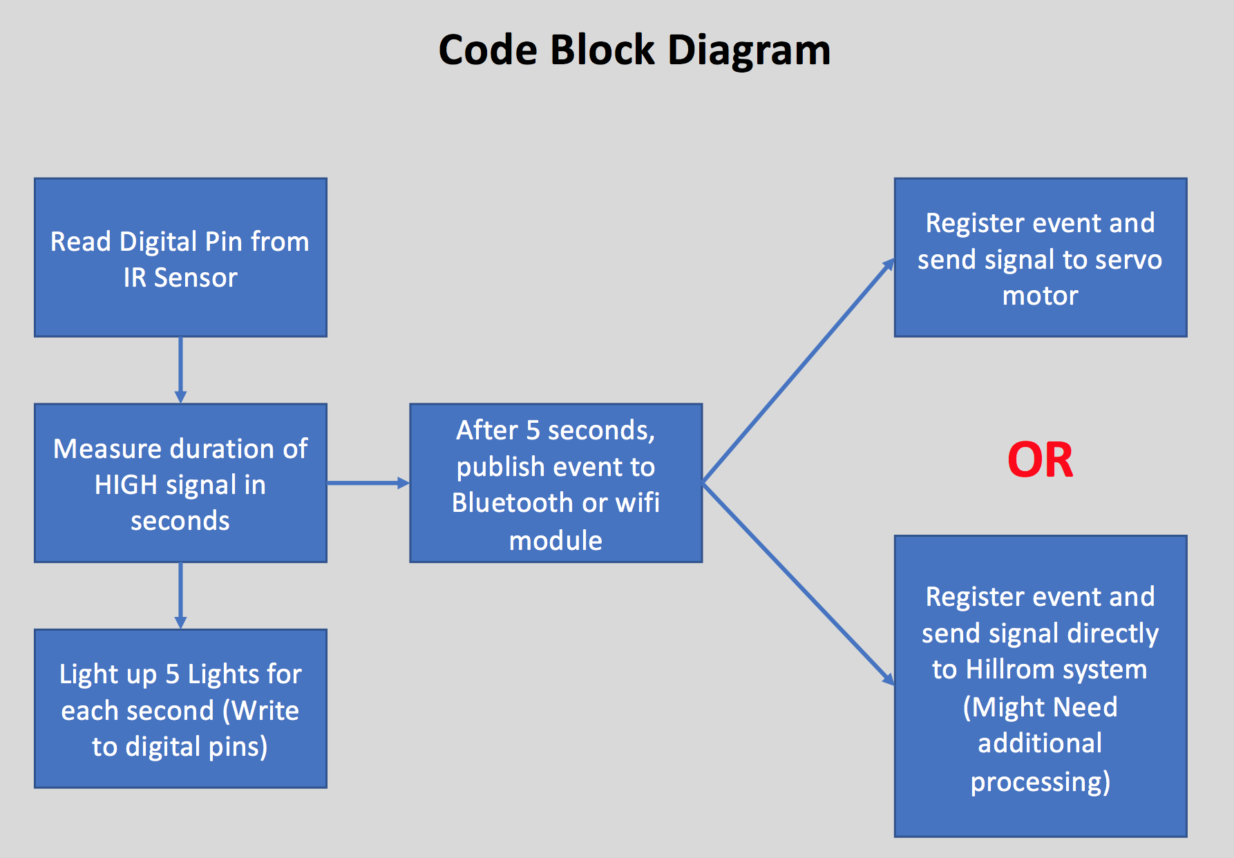
Prototyping Objectives: Code Block Diagram

Slide 11
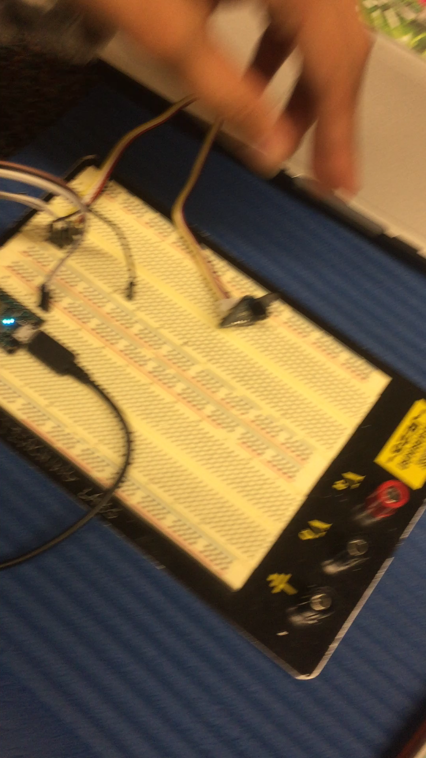
Prototyping Objectives: Working Device

Slide 12
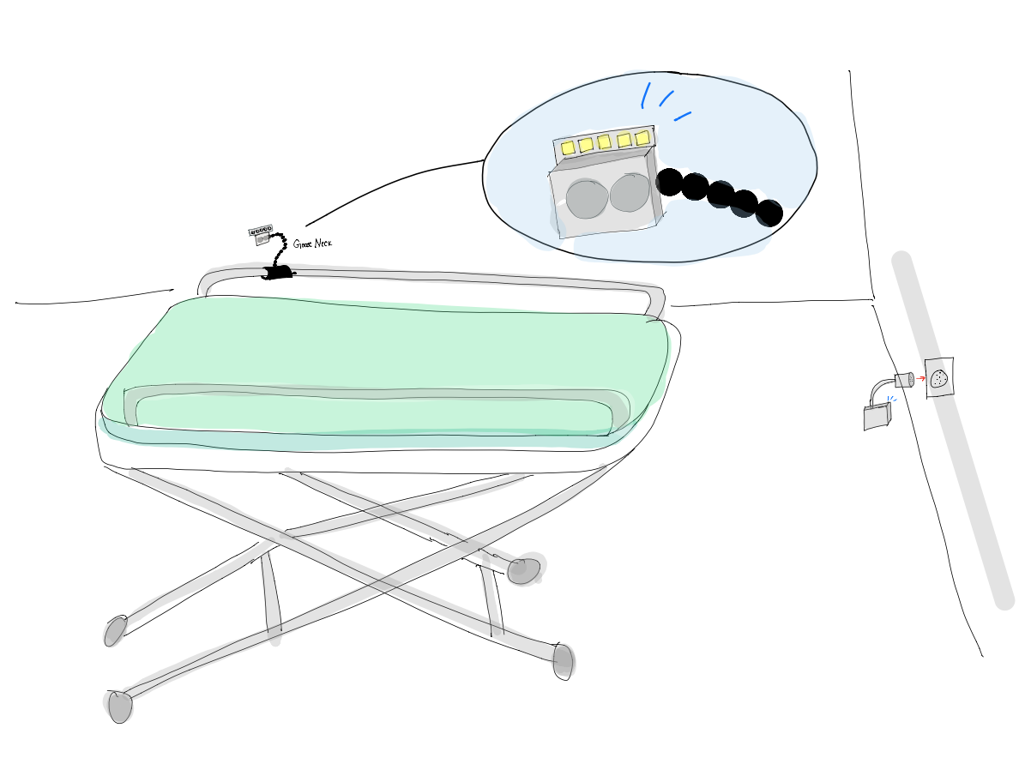
Prototyping Objectives: Drawings
Notes:
Liz add screenshots of solidworks files

Slide 13
Next Steps and Conclusion

